Slide 1
Deep Learning
Overview
Joseph E. Gonzalez
jegonzal@cs.berkeley.edu
Borrowed heavily from excellent talks by:
Adam Coates: http://ai.stanford.edu/~acoates/coates_dltutorial_2013.pptx
Fei-Fei Li and Andrej Karpathy: http://cs231n.stanford.edu/syllabus.html

Slide 2

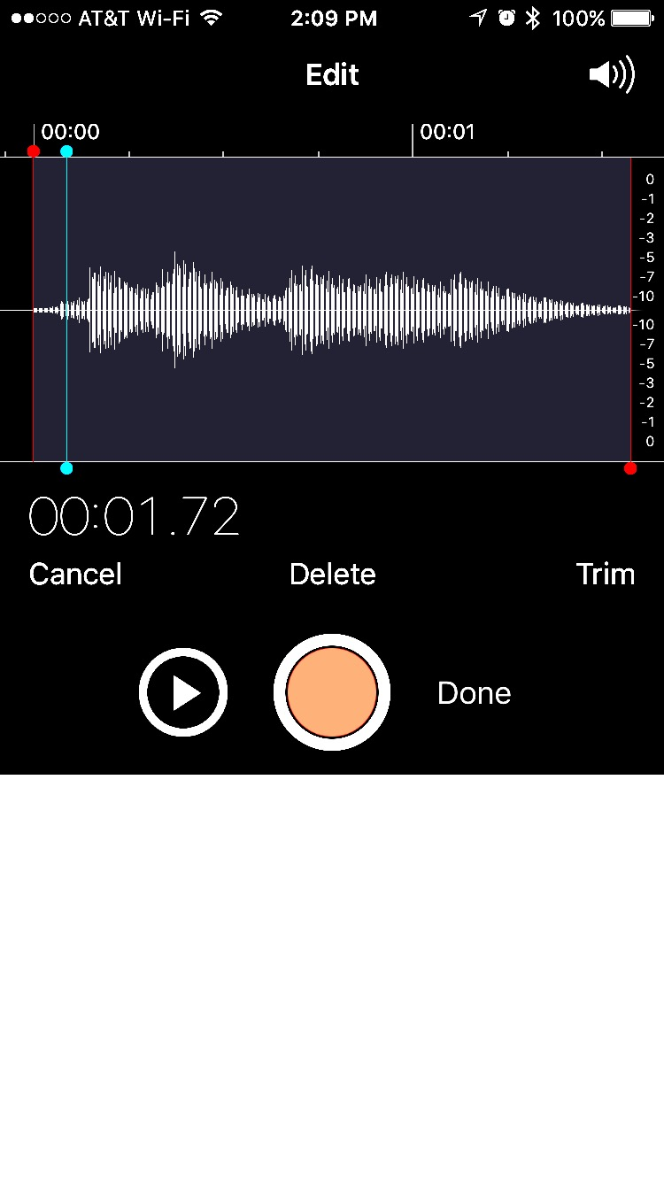
Machine Learning ➔ Function Approximation
Object Recognition
Speech Recognition
“The cat in the hat”
Label:Cat
Robotic Control
Machine Translation
El gato en el sombrero
The cat in the hat.

Slide 3
Function Approximation Pipeline
Object Recognition
Label:Cat
Speech Recognition
“The cat in the hat”

Slide 4
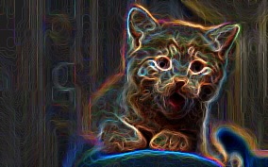
Function Approximation Pipeline
Object Recognition
SVM
Label:Cat
Speech Recognition
HMM
“The cat in the hat”

Slide 5
Function Approximation Pipeline
SVM
Label:Cat
Often build multiple layers of features to abstract the input
SVM
Label:Cat
Deep learning tries to automated this process.

Slide 6
Function Approximation Pipeline
Learn more abstract representation
SVM
Low-level
Features
Mid-level
Features
High-level
Features
Label:Cat
Deep Learning: automatically learn a deep hierarchy of abstract features along with the classifier.
Typically using neural networks
composable general function approximators

Slide 7
Why is Deep Learning so Successful?
Feature engineering essential to many applications
Expensive hand-engineering of “layers” of representation.
Deep learning automates the process of feature engineering
Previous attempts were limited by data and computation
We now have access to substantial amounts of data and computation
Deep learning techniques are inherently compositional
Easy to extend and combine → rapid development

Slide 8
Crash Course in Neural Networks

Slide 9

Supervised Learning
Predict is this a picture of a cat?

Slide 10
Supervised Learning
Predict is this a picture of a cat?
and training data:
Learn a function:
By estimating the parameters w
=

Slide 11
Logistic Regression for Binary Classification
Consider the simple function family:
With non-linearity:

Slide 12
Logistic Regression as a “Neuron”
Consider the simple function family:
“perceptron”
Neuron “fires” if weighted sum of input is greater than zero.
w₂₃x₂₃
w₅₂x₅₂
w₁₂₃x₁₂₃
Bias= w₀ x

Slide 13
Learning the logistic regression model
Consider the simple function family:
Goal: find w that minimizes the loss on the training data:
likelihood

Slide 14
Numerical Optimization
Gradient Descent:
Convex → Guaranteed to find optimal w
Stochastic gradient descent:
Slow
Approximate

Slide 15
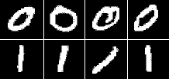
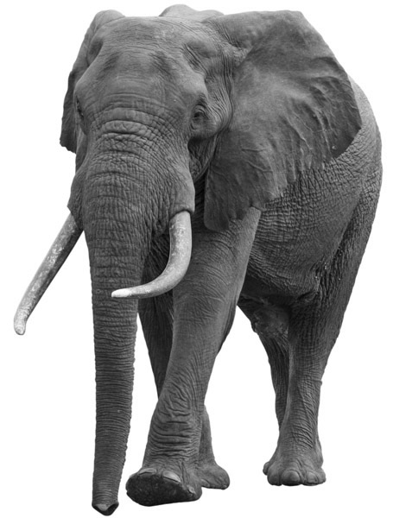

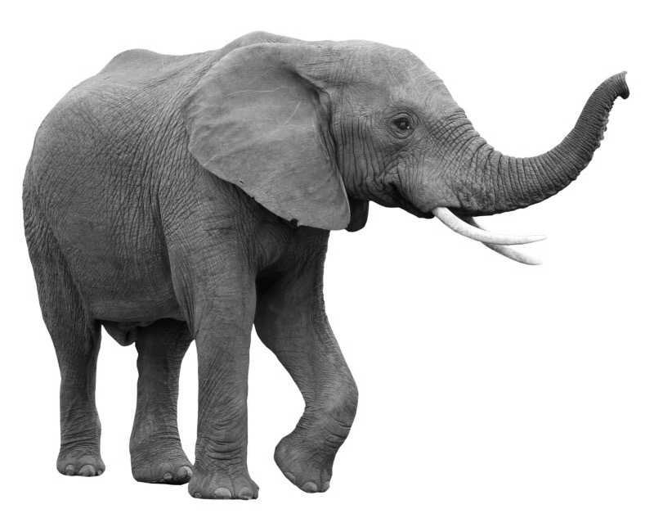
Logistic Regression: Strengths and Limitations
Widely used machine learning technique
convex → efficient to learn
easy to interpret model weights
works well given good features
Limitations:
Restricted to linear relationships → sensitive to choice of features
y = 0
y = 1
0
1
2
Pixel 2
Pixel 2
1
1
0
Pixel 1
Pixel 1

Slide 16
Feature Engineering
0
1
2
Pixel 2
Pixel 2
1
1
0
Pixel 1
Pixel 1
Rather than use raw pixels build/train feature functions:
1
=
1
(Paws, Furry)
Furry
0
0
Paws

Slide 17
Composition Linear Models and Nonlinearities
d
Input Layer
(Pixels)
W⁰
x₁
z
z
h₁
𝜎
k
=
k
k
=
k
h₂
x₂
h_{k}
1
1
1
d
x_{d}
1

Slide 18
Composition Linear Models and Nonlinearities
d
Input Layer
(Pixels)
k
W⁰
x₁
z
z
W¹
z
z
𝜎
h₁
𝜎
h₁
k
k
k
2
=
=
=
2
2
2
h₂
h₂
x₂
k
h_{k}
1
1
1
1
1
1
d
x_{d}
1

Slide 19
Neural Networks
Composing “perceptrons”
W⁰
W¹
x₁
W²
x₂
f
Input Layer
x_{d}
Hidden Layers

Slide 20
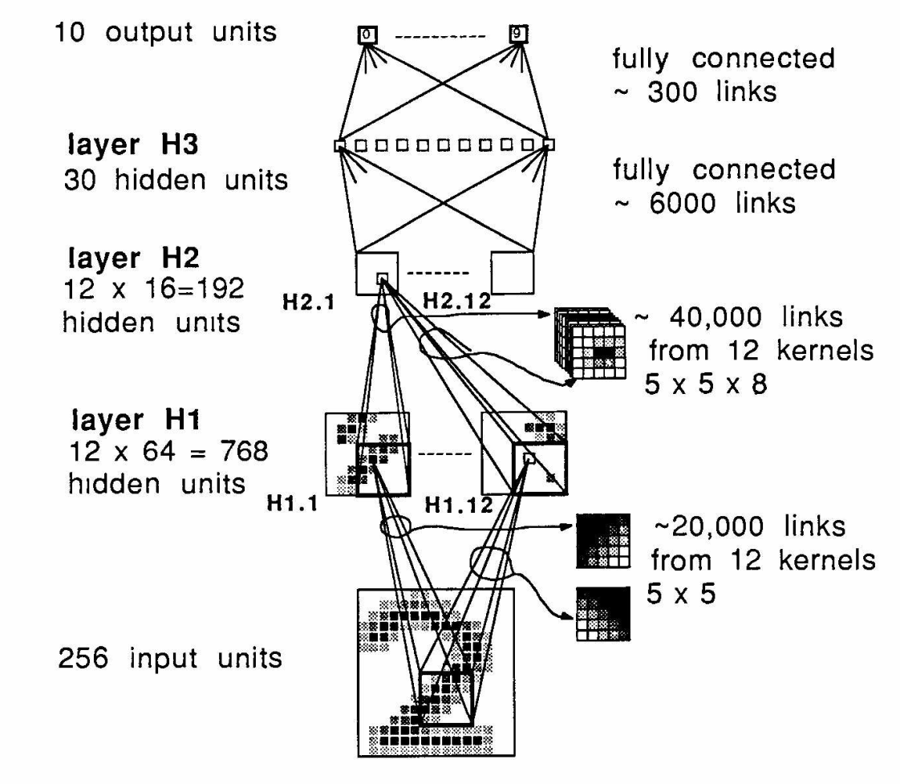
Deep Learning →Many hidden layers …
Output
Output
Input
Logistic Regression

Slide 21
Neural Networks
Composing non-linear models (e.g., Logistic Regression):
Learn W⁰, W¹, and W² using Backpropagation + SGD
W⁰
W¹
x₁
W²
x₂
f
Input Layer
x_{d}
Hidden Layers

Slide 22
Backpropagation in Neural Networks
Need to compute the gradient of the loss wrt. W⁰, W¹, and W²
Use chain rule to push gradients back through dataflow graph:

Slide 23
Backpropagation in Neural Networks
Define a general operator:
g(w, h)
h
g
W_{kl}

Slide 24
Backpropagation in Neural Networks
Define a general operator:
g(w, h)
h
g
W_{kl}

Slide 25
Simple Example:
2
x
12
12
5
= 5
+
= 3
h₁ * y
3
12
12 = 4*3
y
15
32=12+20
⨯
60
20 = 4*5
⨯
4
1
4
z
15
15
= 15
= 4
h₂ * z

Slide 26
Backpropagation
Requires all operators to have well defined sub-gradients:
Enables Automatic Differentiation!
User defines forward flow → system derives efficient training alg.
Easy to explore composition of new modules
Enables Efficient Gradient Computation
Cache forward calculation to accelerate gradients
Compile optimized gradient computation
tanh
logit
Relu = max(0,x)
abs

Slide 27
General Purpose Systems For DNNs
Distributed Parameter Servers
TensorFlow (DistBelief)
Microsoft Adam
GPU Systems
TensorFlow
Caffe
Theano
Demo of TensorFlow

Slide 28
Challenges of Deep Neural Networks
Non-convex → (stochastic) gradient descent not guaranteed to converge to optimum
Soln: appear to be many good local optima
High-dimensional → gradient descent converges slowly
Soln: hardware acceleration, improved algs. with momentum …
Rich function class → overfitting
Soln: more data, early-stopping, drop-out, parameter sharing
Saturation of sigmoid → decaying gradients
Soln: other forms of non-linearity
logit
Relu = max(0,x)

Slide 29

Convolutional Neural Networks: Exploiting Spatial Sparsity

Slide 30
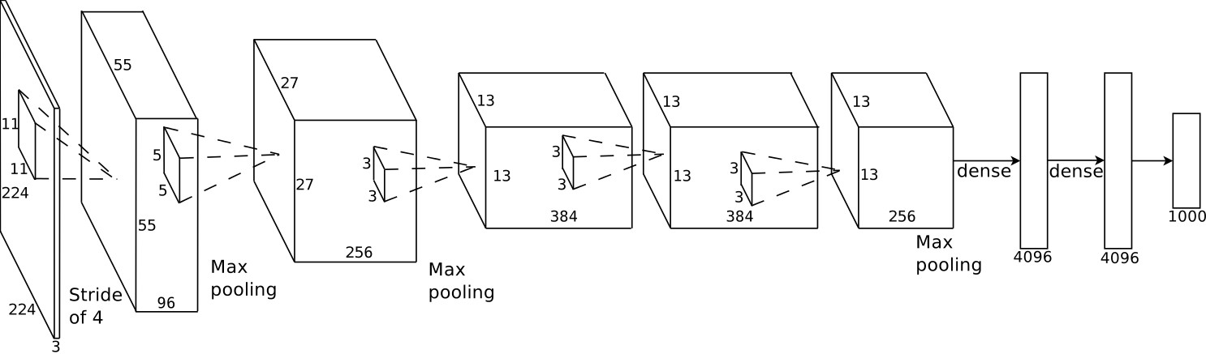
Example: AlexNet (Krizhevsky et al., NIPS 2012)
Introduced in 2012, significantly outperformed state-of-the-art (top 5 error of 16% compared to runner-up with 26% error)
Covered in reading …

Slide 31
Growth in Model Complexity
LeCun et al, “Backpropagation Applied to Handwritten Zip Code Recognition”. 1989
Szegedy et al, “Going Deeper with Convolution”. 2014
Winner of ImageNet Large-Scale Visual Recognition Challenge 2014
GoogLeNet (7.89% error)
22 layers
6.8M parameters
1.5B flops
Ensemble of 7 models
Current Best: ResNet (3.57% error)
152 layers
2.3M parameters
11.3B flops
Ensemble of 6 models
9K Parameters
66K Ops
Notes:
(12 * (5*5)) + (12 * 5 *5 *8) + 6000 + 300 = 9K parameters
20000 + 40000 + 6000 + 300 = 66K Ops
2700 + 112000 + 159000 + 380000 + 364000 + 437000 + 463000 + 580000 + 840000 + 1072000 + 1388000 + 1000000 =~ 6.8M
34*10^6 + 360*10^6 + 128*10^6 + 304*10^6 + 73*10^6 + 88*10^6 + 100*10^6 + 119*10^6 + 170*10^6 + 54*10^6 + 71*10^6 + 1*10^6
7*7*64 + 3*3*64 + 3*3*64 + 3*256 + 8*128 + 3*3*128*8 + 36*256 + 36*256*3*3 + 36*1024 + 3 * 512 + 3*3*512*3 + 3 *2048 * 1000

Slide 32
Cost of Computation (from Prediction Serving Lecture)
100’s of millions of parameters + convolutions & unrolling
Requires hardware acceleration
http://www.nvidia.com/content/tegra/embedded-systems/pdf/jetson_tx1_whitepaper.pdf

Slide 33
Improvement on ImagNet Benchmark

Slide 34
Recurrent Neural Networks: Modeling Sequence Structure
El gato en el sombrero
The cat in the hat.
State of the art in speech recognition and machine translation
Required LSTM and GRU to address long dependencies
Similar to the HMM from classical Bayesian ML

Slide 35
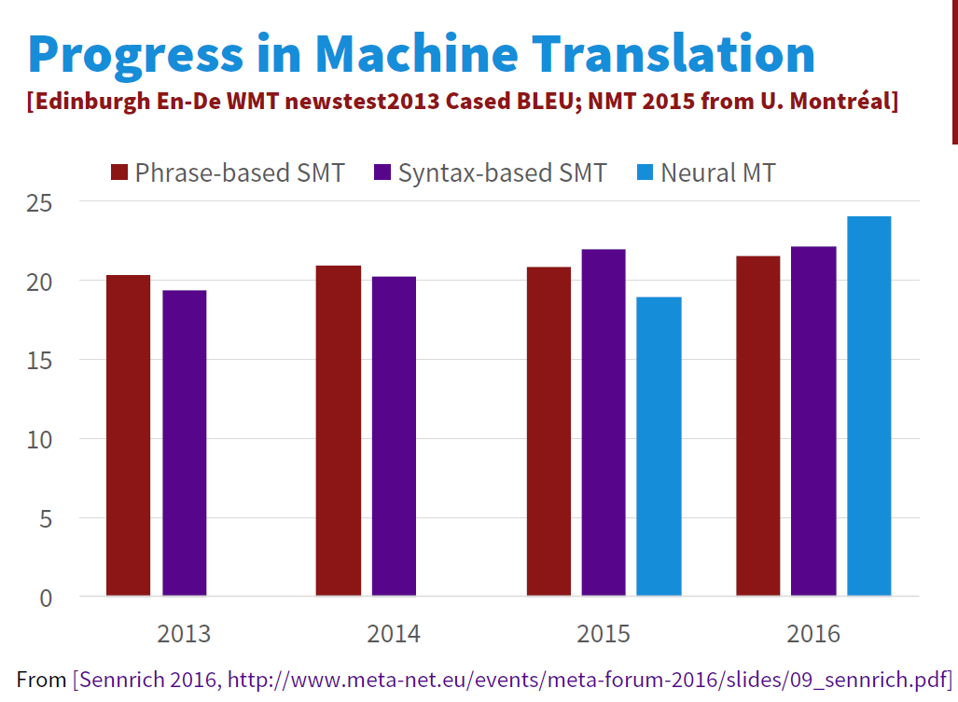
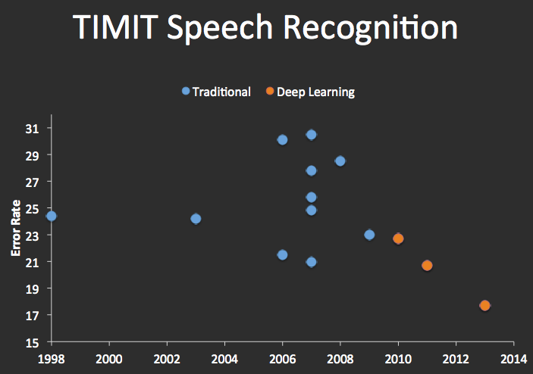
Improvements in Machine Translation & Automatic Speech Recognition

